Slide 1
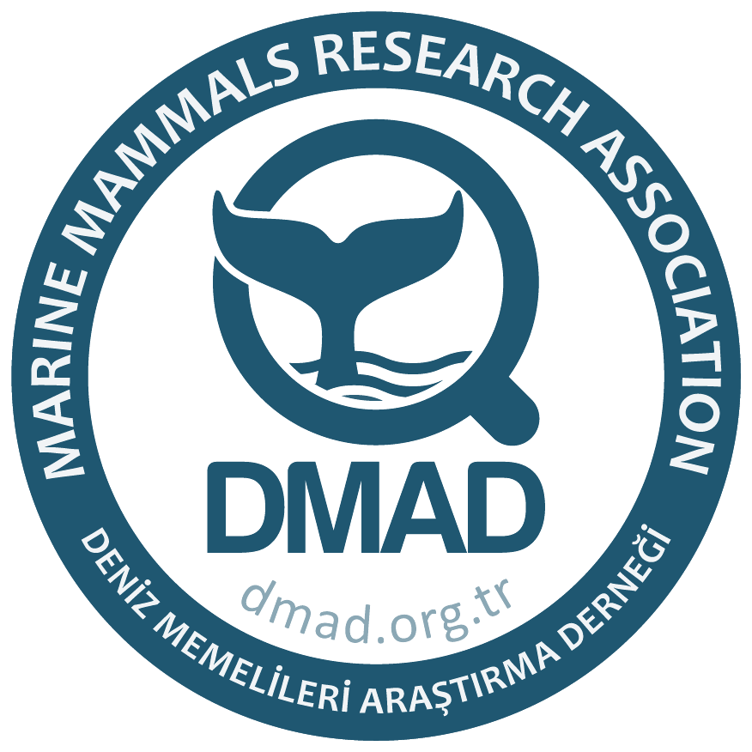
Marine Mammals and Why Should We Protect Them!

Slide 2
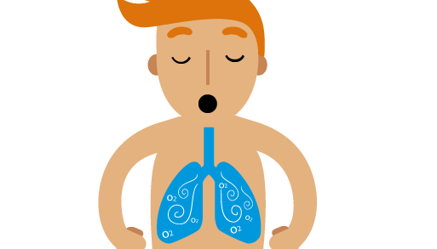
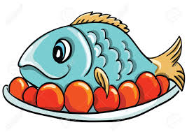
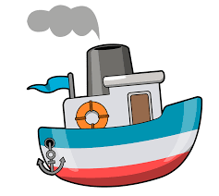
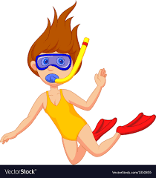
Why are oceans important?
Notes:
The ocean covers 70% of the earth. There are 5 oceans (Pacific, Atlantic, Indian, Southern and Arctic) across the world and 100 seas.
Who knows what sea is next to us here in Montenegro? The Mediterranean Sea but more specifically the Adriatic Sea.
The ocean produces 70% of the oxygen we breath.
Oceans help control the weather.
We mainly use oceans for seafood, transportation and fun (recreational activities).
We have only explored 5% of the world’s oceans.
Possible Questions:
How do oceans help control the weather? Oceans store solar radiation and help distribute it around the world, when the water molecules are heated they evaporate which increases the temperature and humidity of the surrounding air to form rain and storms.

Slide 3
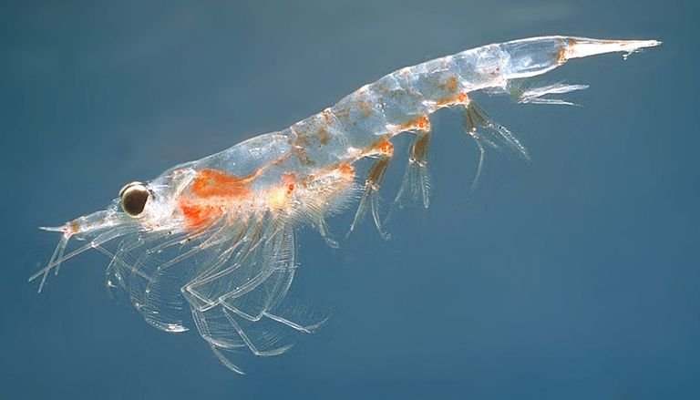
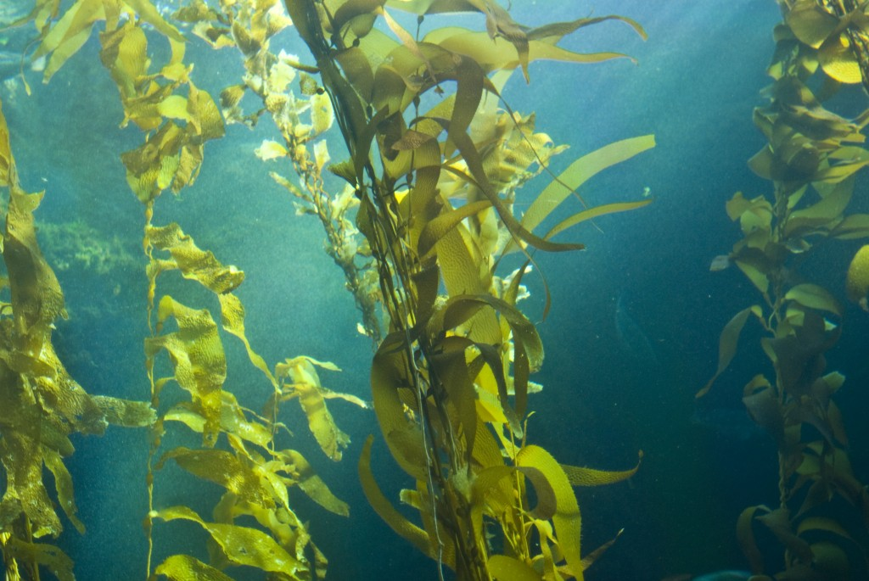
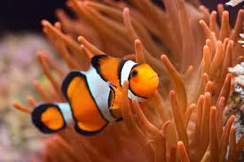
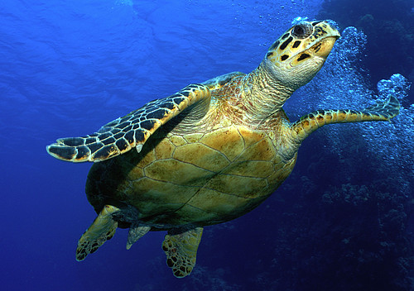
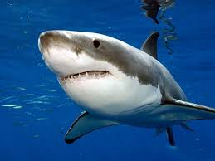
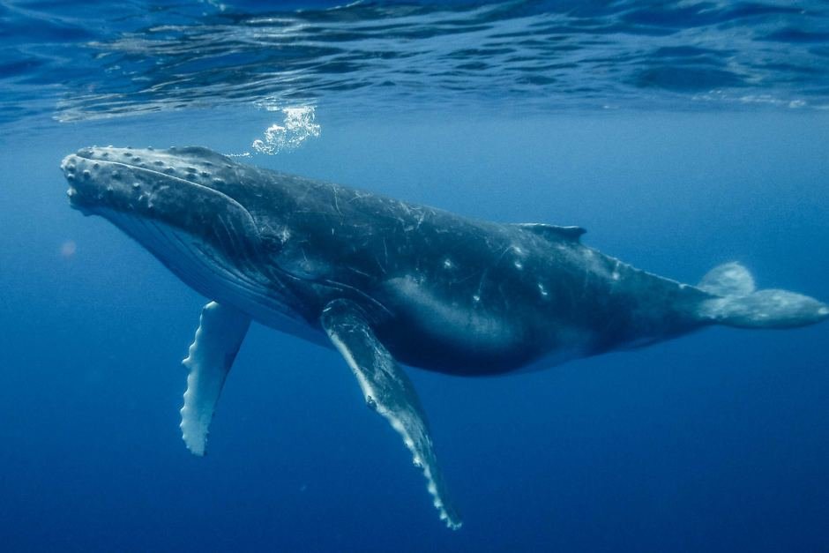
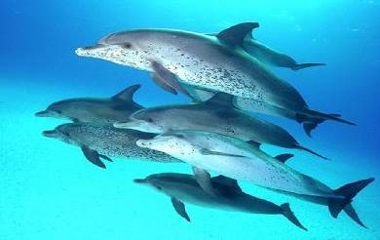
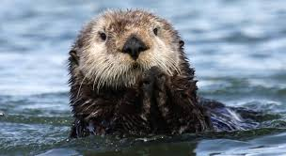
Who lives in the ocean?
Krill
Kelp
Clownfish
Hawksbill Sea Turtle
Great White Shark
Sea Otter
Blue Whale
Atlantic Spotted Dolphins
Notes:
Microorganisms such as plankton
Plants such as kelp
Animals such as fish, crabs, shrimp, octopus, squid, turtles, sea otters, polar bears, whales and dolphins
What’s your favorite animal that lives in the ocean?

Slide 4
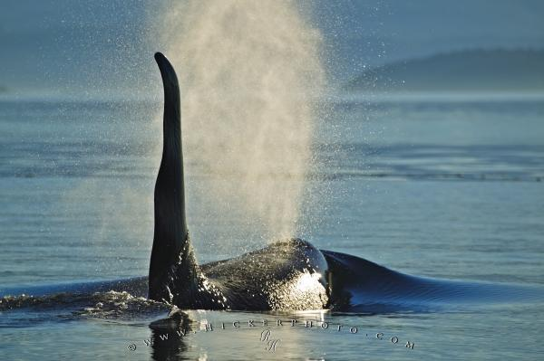
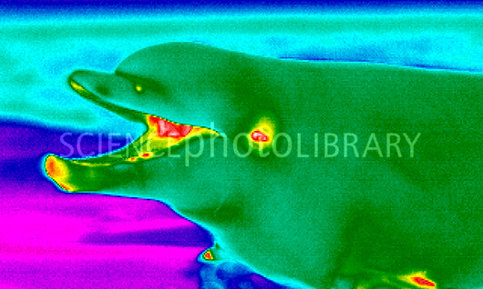
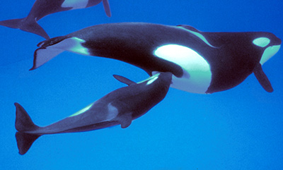
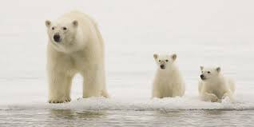
What is a Marine Mammal?
Notes:
Some animals living in the ocean are called marine mammals. These animals breath air, are warm-blooded, produce milk to feed their young, give birth to live young and in some cases they even have hair like polar bears.

Slide 5
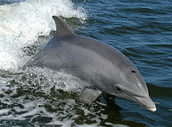
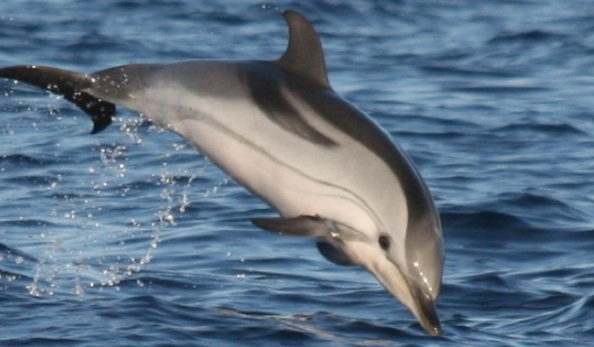
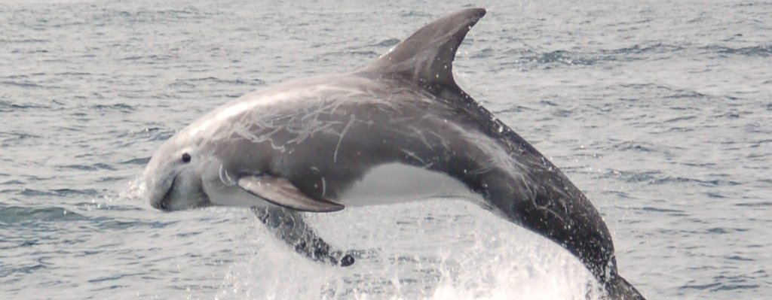
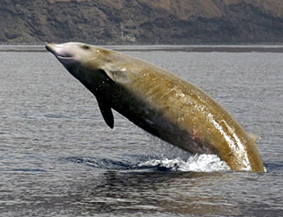
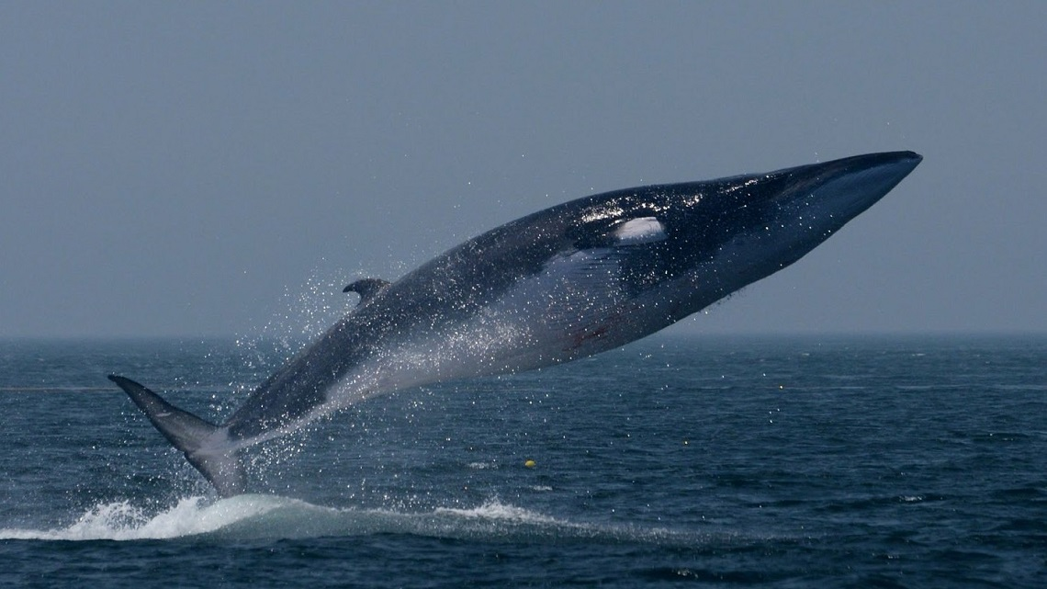
What Marine Mammals are found in Montenegro?
Bottlenose dolphin
Striped dolphin
Risso’s dolphin
Fin whale
Cuvier’s beaked whale
Notes:
Have any of you seen these marine mammals?

Slide 6
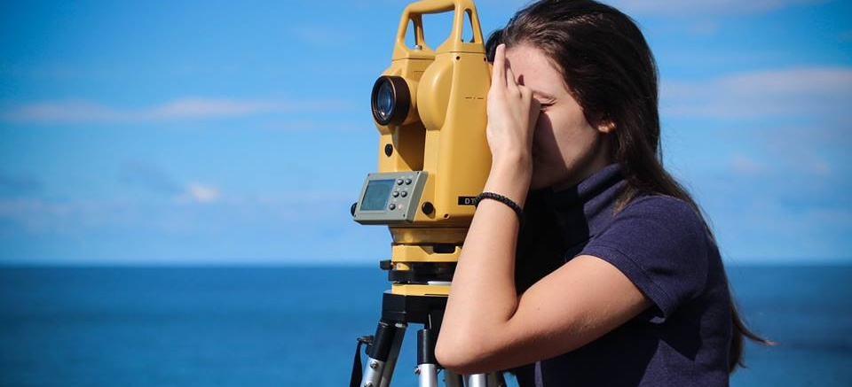
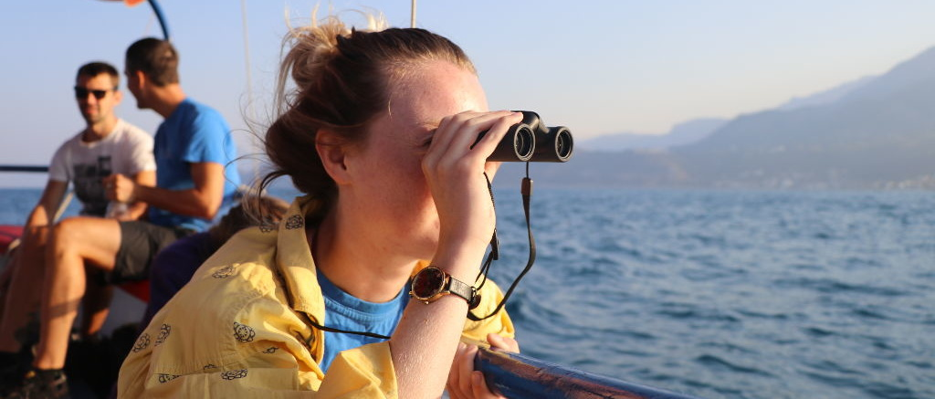
Who we are?
Notes:
We are here to record all the species that we see in Montenegro and surrounding areas. We do this by observing the ocean for marine mammals on land and on boats. We also get information from fisherman on if they have seen any marine mammals in the area. We chose Montenegro because there has been little research on what marine mammals are found here. Getting this information will allow us to help protect them and the coast of Montenegro.

Slide 7
Fun facts
Notes:
Now we’re going to talk about some fun facts about dolphins.
Do any of you know what a dolphin sounds like? Can you imitate that sound?

Slide 8
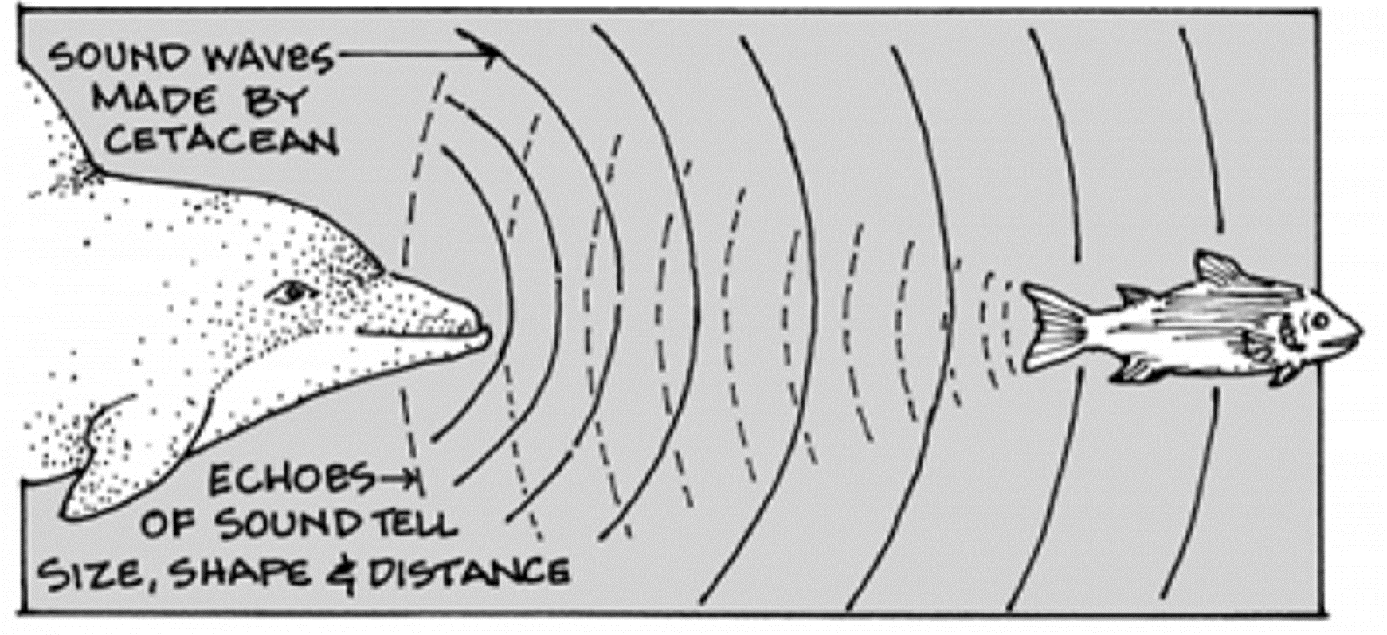
Notes:
Dolphins communicate using echolocation, this helps them see underwater. Echolocation is when they release a sound from their head when the sound waves hit an object they return to the dolphins as echo's.

Slide 9
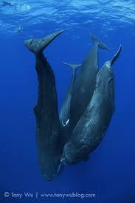
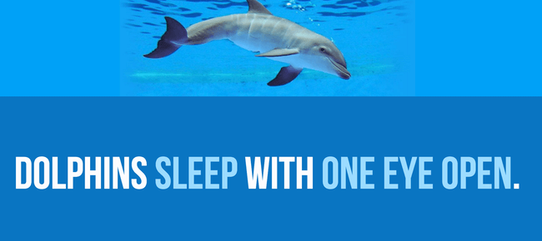
Notes:
Whales and dolphins have to think to breath rather than breathing automatically like us humans do. For this reason, whales and dolphins have developed a sophisticated technique for sleeping: while they turn off one half of their brain (which can sleep), the other half remains active, reminding the whale go to the surface to breath air. While one half of the brain is asleep, the eye on the opposite side closes.

Slide 10
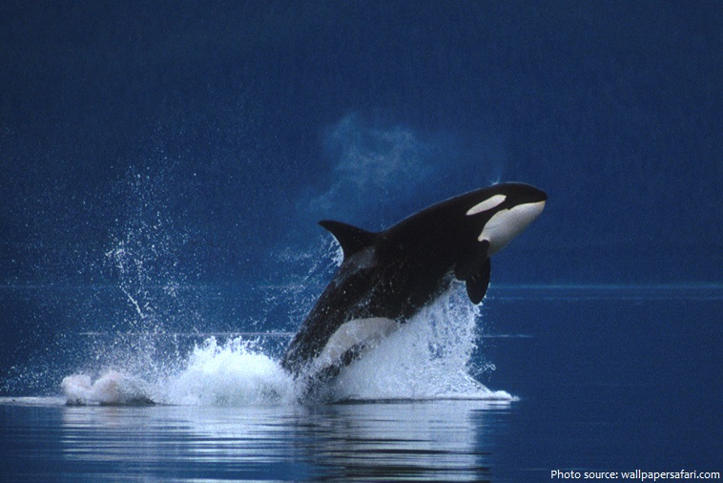
Notes:
Can any of you tell me what this is?
Orca’s or Killer whales are actually dolphins.

Slide 11
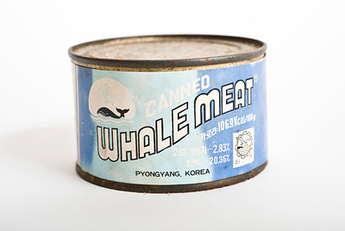
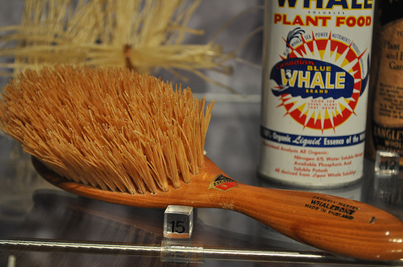
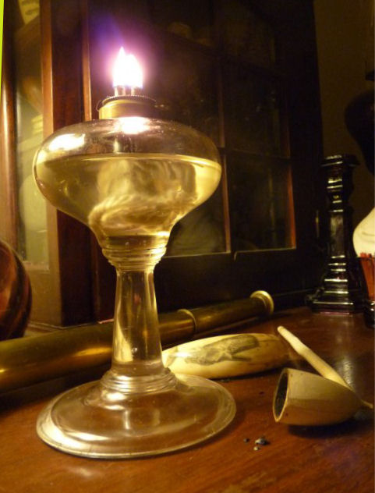
Past Threats
Notes:
Whale hunting has been going on for thousand of years, the first records of whale hunting were about 4,000 years ago. It became really popular in the early 1900s and then declined when alternative fossil fuels were found. However by that point a lot of whales had already been killed which led to lots of endangered species.
Why do you think people hunted whales?
They hunted whales for their meat. They also used whale baleen from their mouth for hair brush bristles, woven into baskets, carriage springs and umbrella ribs. They used their blubber for oil lamps, soaps, heating and paint. They also used bones for tools.
Most of these threats are no longer present but some cultures still hunt whales for food and medicine which can lead to extinction of the species.

Slide 12
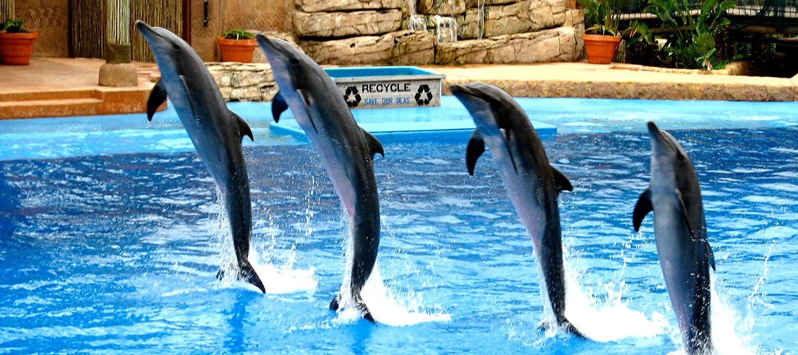
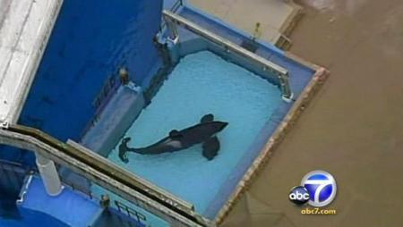
Current Threats
1. Captivity
Notes:
Taking marine mammals out of the wild to put them in aquariums or water parks is bad because…
Individual can no longer contribute to the wild population by having offspring,
Enclosures and tanks aren’t large enough and conditions aren’t like the wild causing animals to be unhealthy and die young.

Slide 13
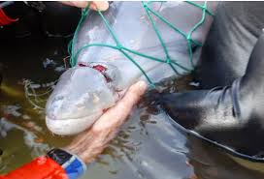
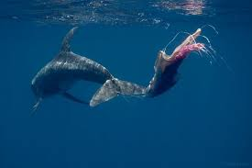
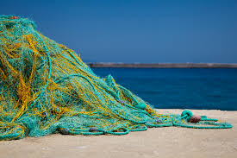
2. Fishing Nets
Notes:
Fishing nets are a threat to marine mammals because…
They can get caught in them leading to injury or death.
This a big problem, can any of you think of a solution?
Solutions: using a pole for fishing so you know what you’re catching
Acoustic alarms on fishing nets which tell the mammals that there is a net there so hopefully they will avoid it, but this is not 100% effective.

Slide 14
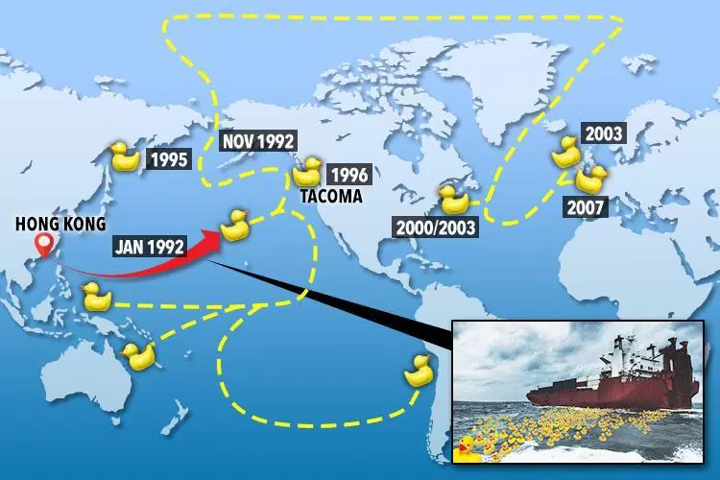
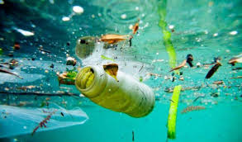
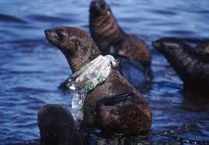
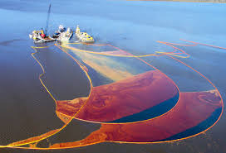
3. Pollution
Notes:
There are many different types of pollution that negatively affect our oceans and marine mammals.
Can you guys name some examples?
One type is plastic and other trash that flows into the ocean.
Fertilizers for farming and household products that contain microbeads (which is tiny particles of plastic) such as some toothpastes, shampoos, body wash.
Drilling for oil in the ocean can also lead to oils spills which harm marine wildlife.
Pollution can also come from boats similar to how cars pollute.
In 1992, a container with 28,000 rubber ducks was swept off the deck of a ship. This amps shows where the container fell off and where and when the rubber ducks were spotted all over the world.

Slide 15
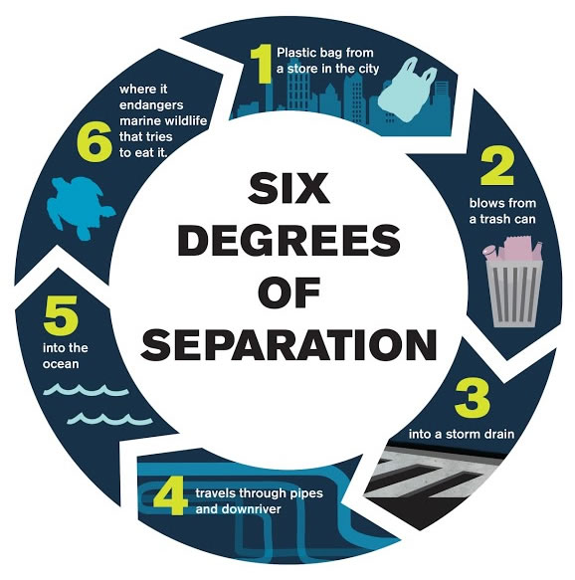
Notes:
As we just talked about plastic is a major pollutant harming the ocean. There are only 6 degrees of separation between you using a plastic bag at the store and it harming marine animals in the ocean. Plastic can be harmful to marine animals in various ways because they try to eat it and it can get caught on them causing injury or even death.
Play Guessing Game for Plastic.
Answers:
Glass Bottle= undetermined
Fishing Line= 600 years
Plastic Beverage Bottle= 450 years
Aluminum Can= 200 years
Styrofoam Cup= 50 years
Cigarette Filter= 1-5 years
Milk Carton= 3 months
Banana Peel= 2-6 weeks

Slide 16
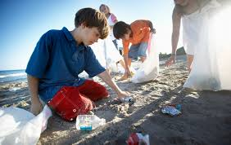
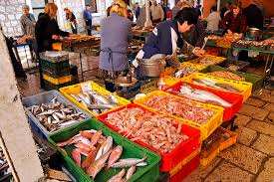
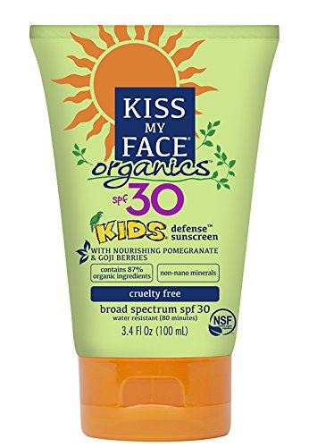
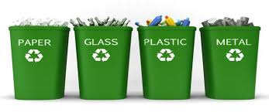
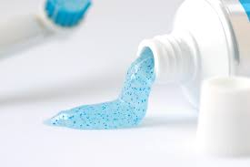
What can you do?
Notes:
You can plan or participate in trash and beach clean ups to prevent it from ending up in the ocean.
Reduce the amount of plastic you use by buying reusable water bottles, reusable shopping bags, asking for no straw with your drink, buying bars of soap instead of bottles of soap.
Reuse and recycle if you do use plastic.
Sustainable seafood is seafood that is caught or farmed in a way that is responsible and won’t harm the environment in the long term. Buying fish from small local fisherman is considered sustainable.
Don’t buy toothpastes or soaps containing microbeads as they wash down the drain and into the ocean.
Buying safe (organic) sun cream can prevent harmful chemicals from entering the ocean when you’re swimming.

Slide 17
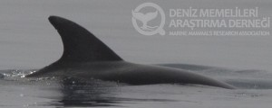
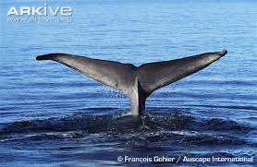
How you can help us?
Volunteer
Donate
Tell your friends and family about marine mammals and us!
Send in pictures to:
www.cetazoom.org
Notes:
Volunteer
Donate
Tell your friends and family about marine mammals, what they can do to help save them and about our organization.
Send in your pictures of dolphins or whales for identification. These pictures should be of the dorsal fin or fluke (that’s what we call the tail) of the marine mammal or of any distinctive markings like battle scars.

Slide 18
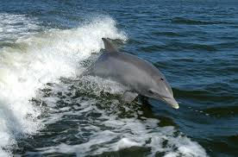
Join us for a Dolphin Watch Adventure!
Contact information:
Phone number: 060024849
Email: info@dmad.org.tr

Slide 19
HELP US SAVE OUR OCEANS!

