Slide 1





Dolphin Discoveries
Dolphin discoveries is meant to teach kids about the fascinating species of dolphins by solving easy assignments.
Just print out the booklet and let the learning begin!
Solutions are given in the end of the book.
Digital Interactive Book for Kids (Draft)
Anna Vollmer

Slide 2
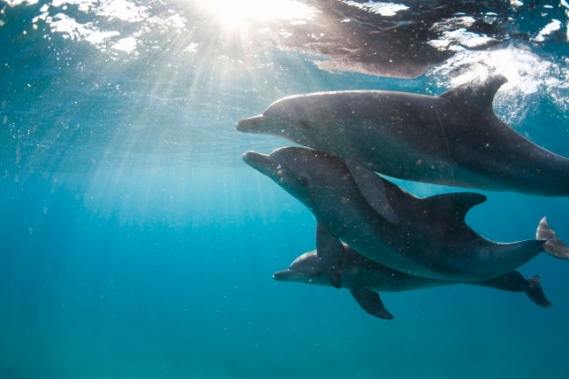
Daisy is a dolphin. She lives together with her parents in the wide ocean. Here, in their natural underwater home, they got everything they need to be happy.
http://blog.afd.org.au/uncategorized/animal-business-why-it-pays-to-be-kind/

Slide 3
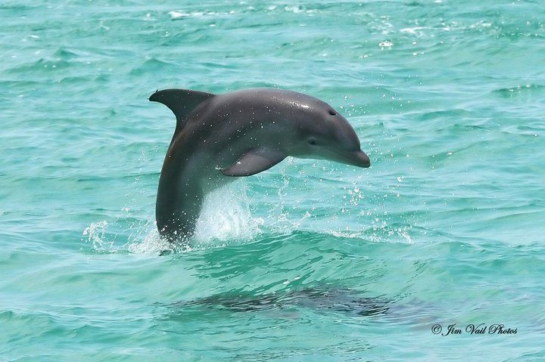

Daisy is a young dolphin.
She loves to travel with her parents, play with the waves, jump out of the water and learn all about the ocean. But the life in the ocean offers some challenges for young dolphins.
Do you want to take up these challenges together with Daisy?
Yes? Great!
Source

Slide 4

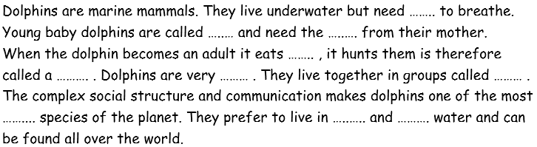
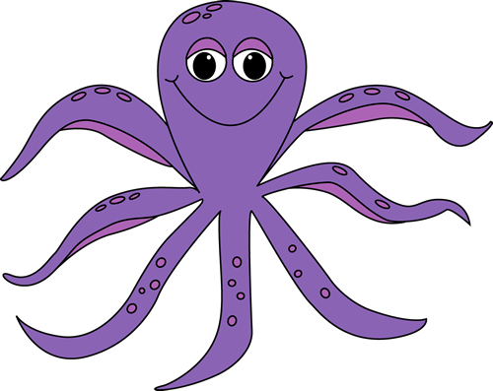
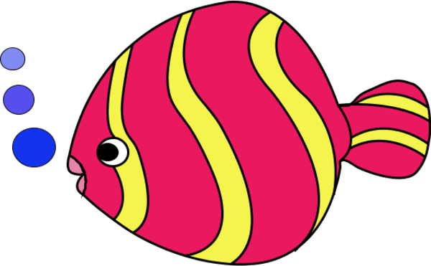
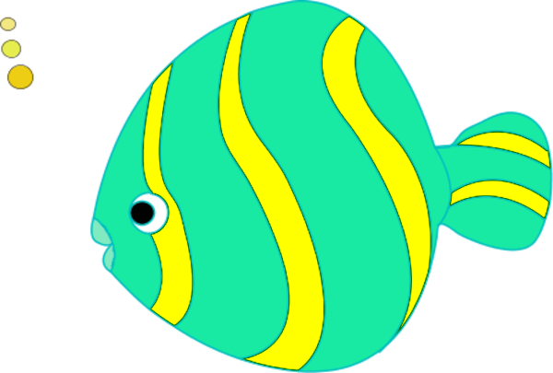

Olli the octopus was so hungry that he took all the important words from our text about dolphins!
Can you help Daisy to put the words back on their right places?

Slide 5

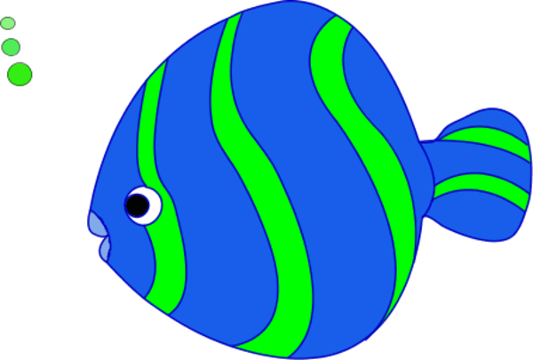
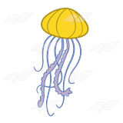
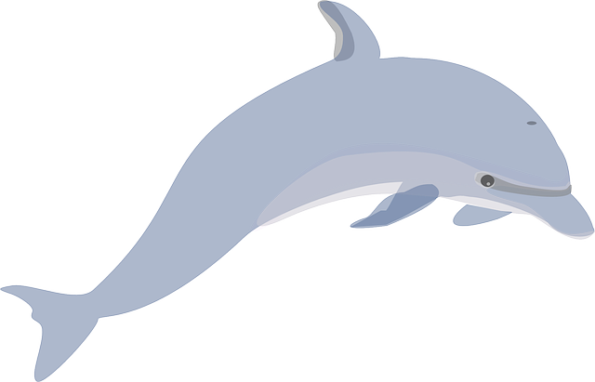
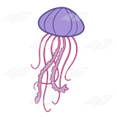
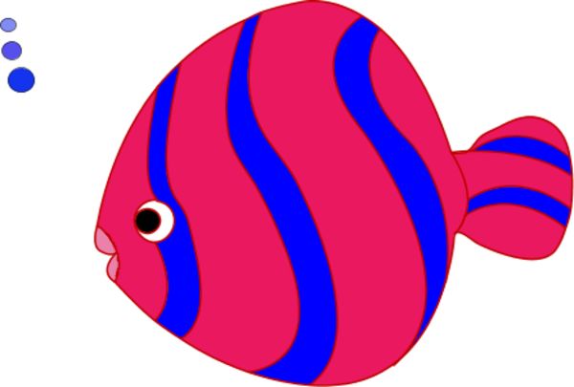
Little dolphins like Daisy still have a lot to learn. She wonders what the different parts of a dolphin’s body are called.
Can you guess the right names?

Slide 6
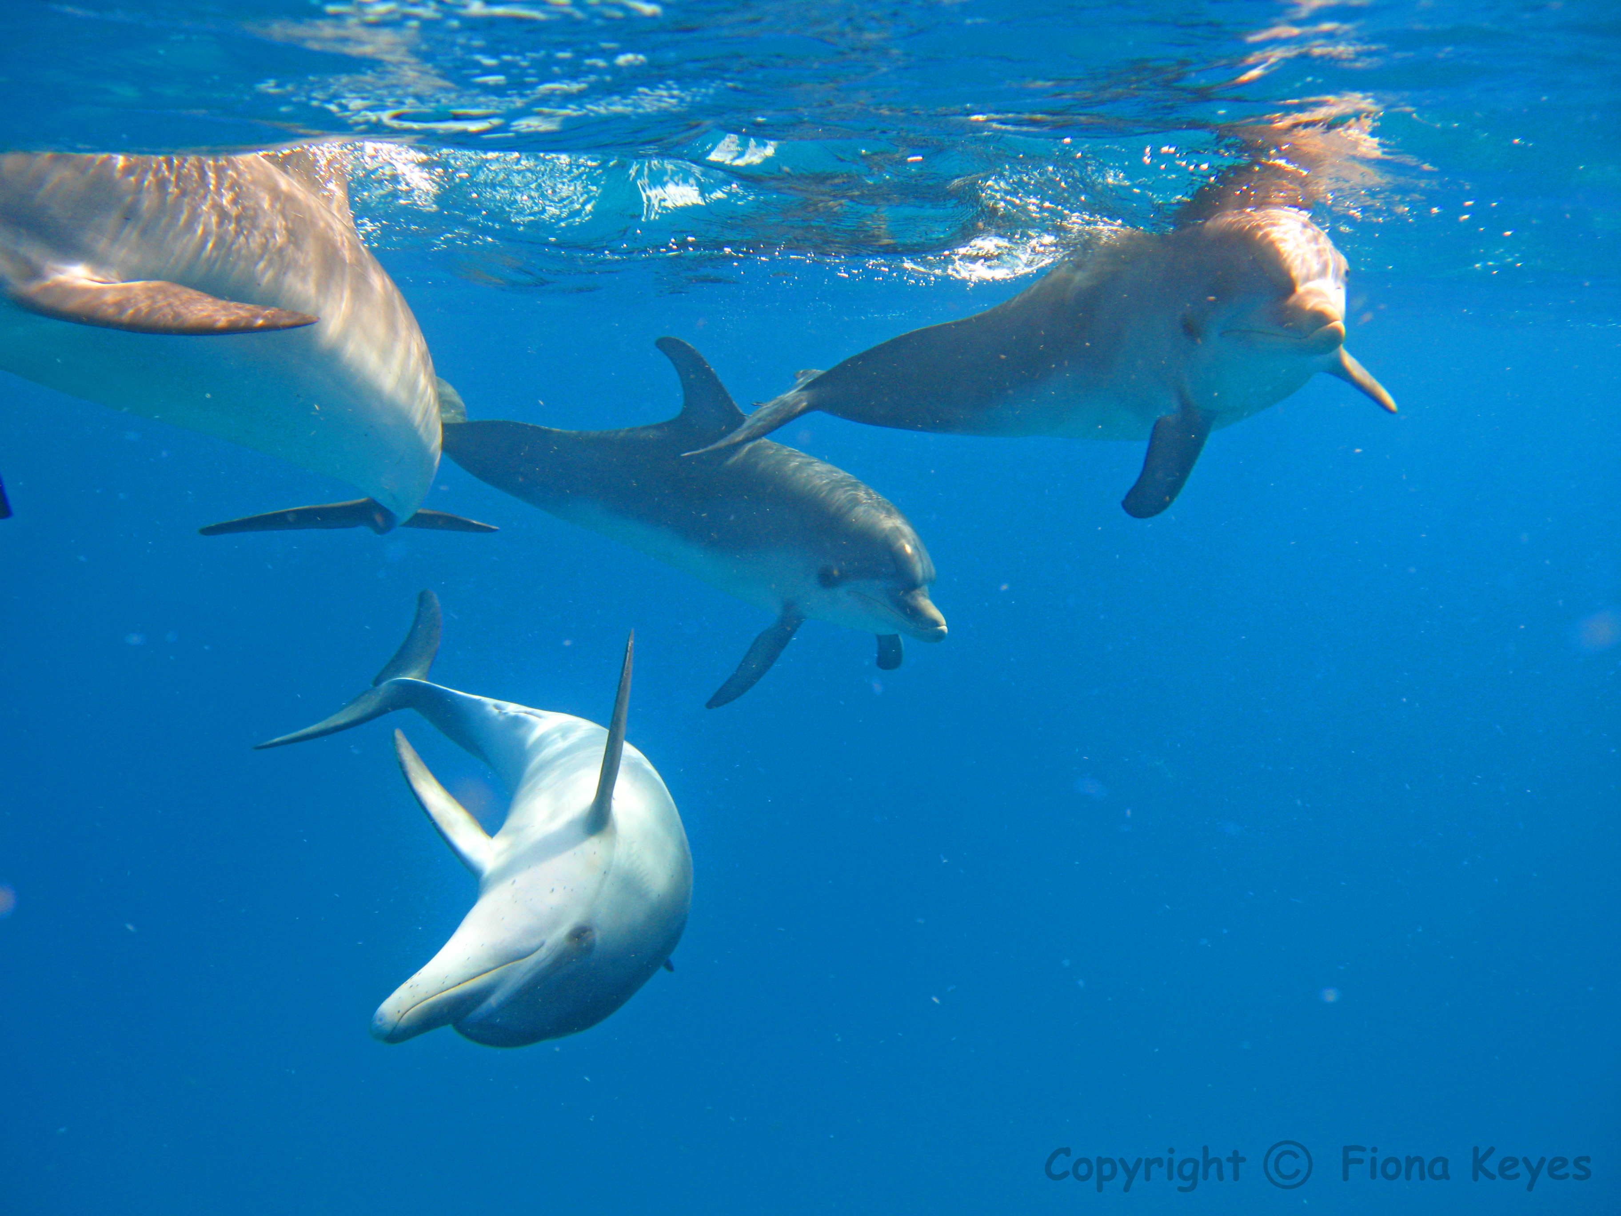
Daisy and her parents are happy but there are several threats for them. These threats can not only harm dolphins but all the other life in the ocean as well!
Source

Slide 7
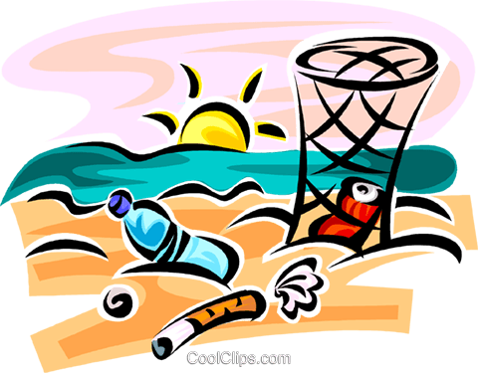
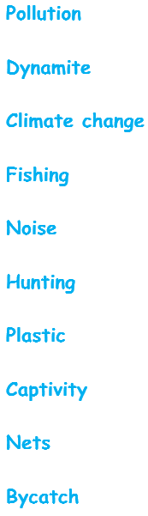
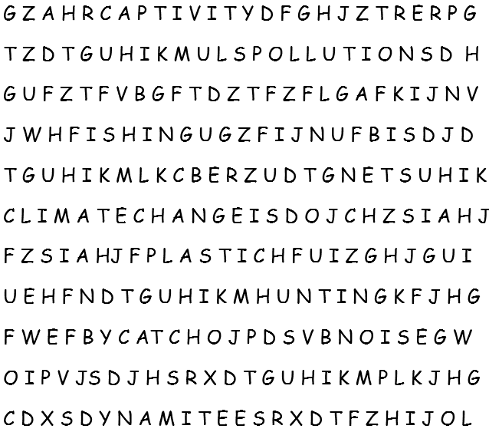

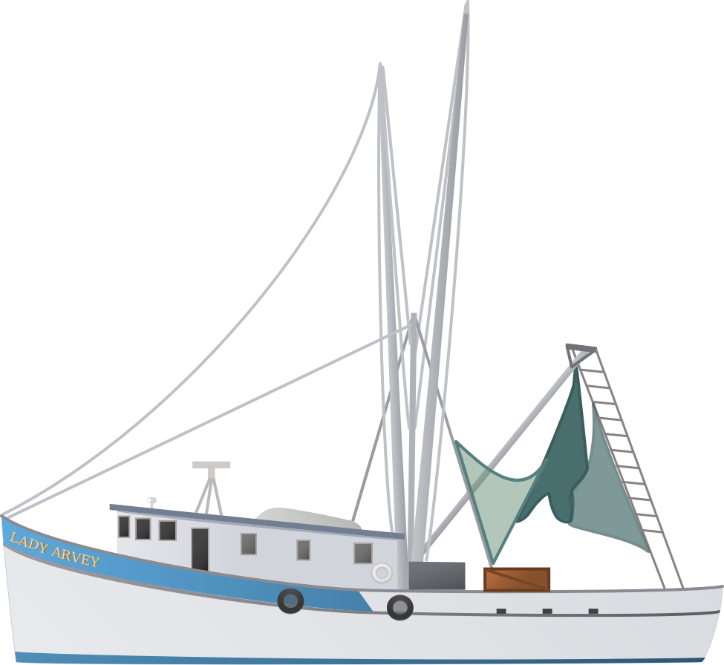
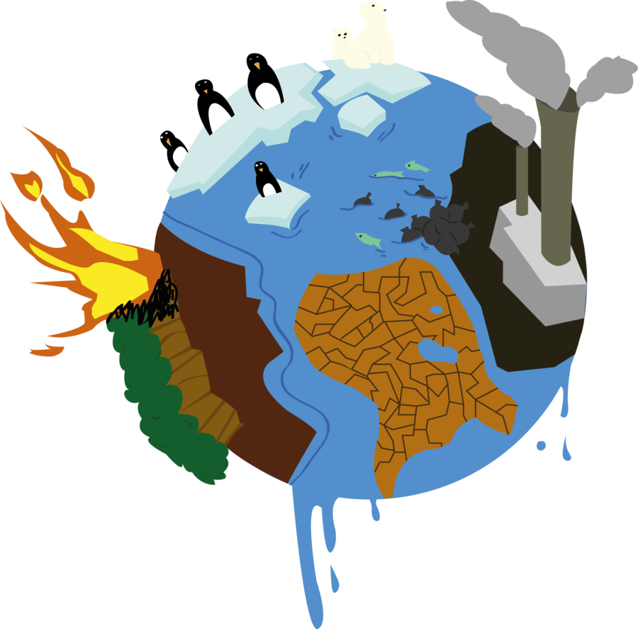


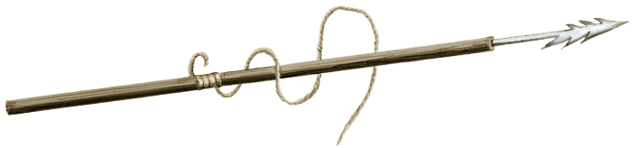


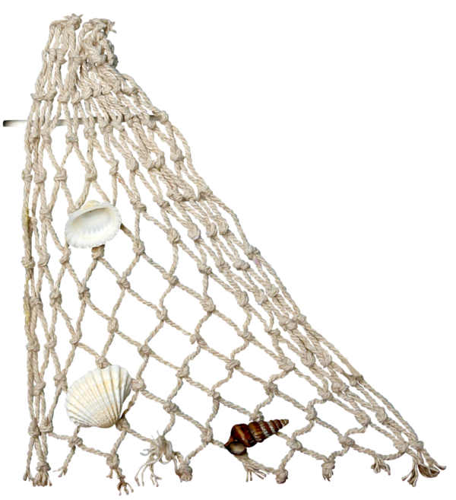
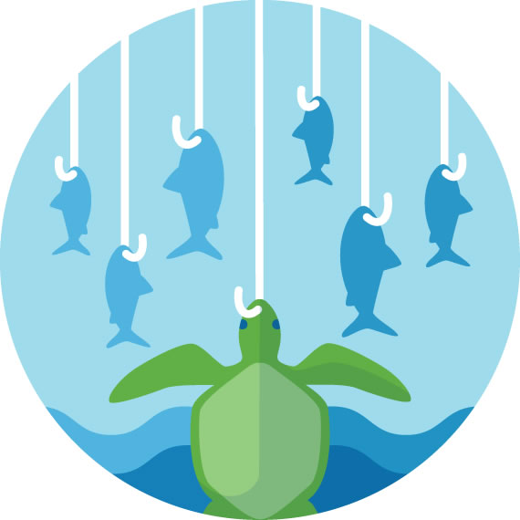
When Daisy is busy with playing and learning, sometimes she doesn’t see the threats that could harm her!
Can you look out for Daisy and find all the threats in the ocean to protect her?

Slide 8
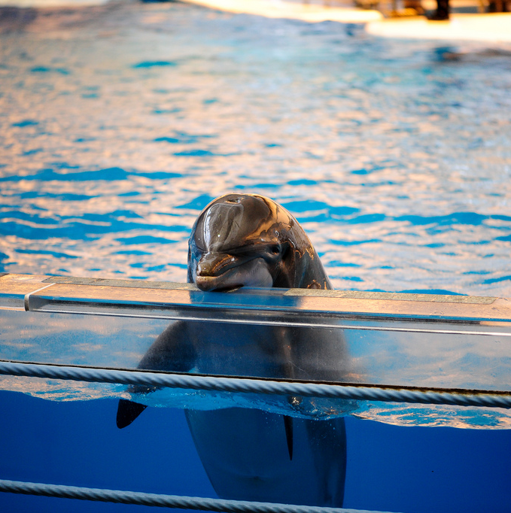
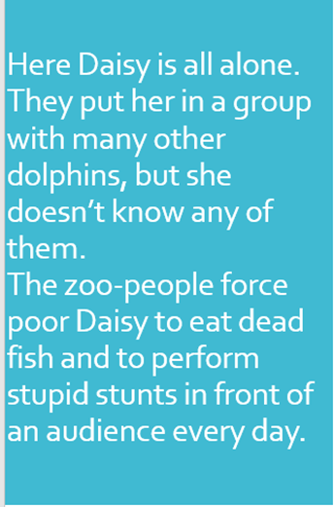



Good that Daisy and you found all the threats. But then one day, evil people from a zoo come to take Daisy away from her parents! They capture her and put her in their prison in the zoo.
Flickr.com, eddie.welker

Slide 9
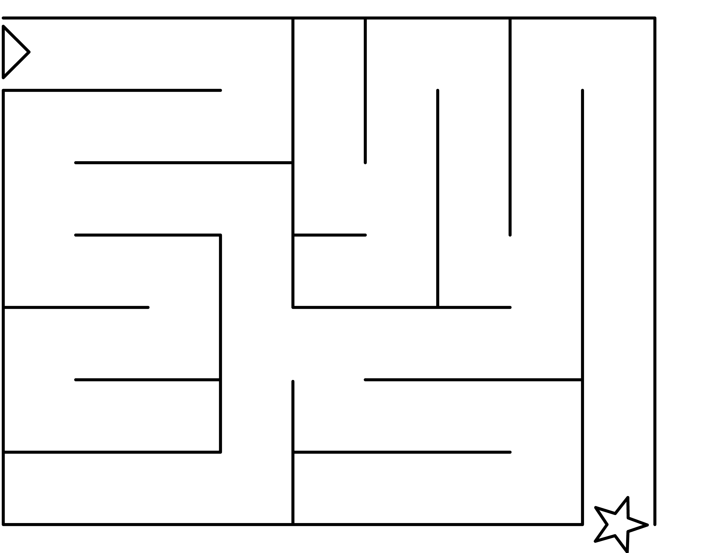








All Daisy wants is to be back in the wild ocean together with her parents.
Luckily a young scientist called ……. comes to rescue Daisy!
Can you help Daisy to escape from the zoo?
Captivity
Freedom!

Slide 10
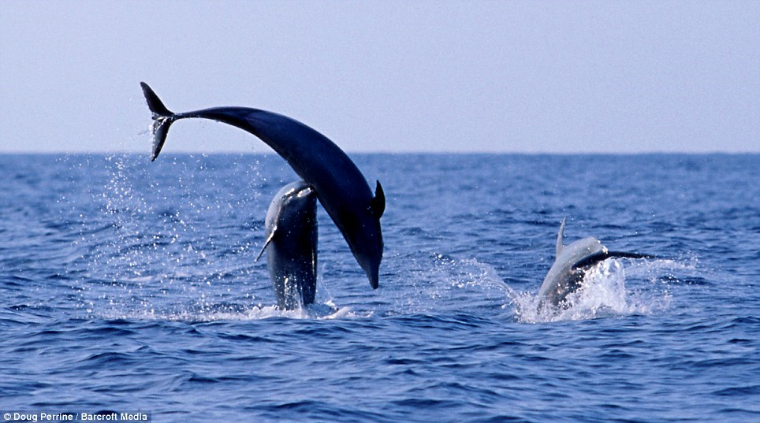

You did it!
Finally Daisy is reunited with her parents. Now she is free again and can spend her life in the ocean where she belongs!
HAPPY END

Slide 11
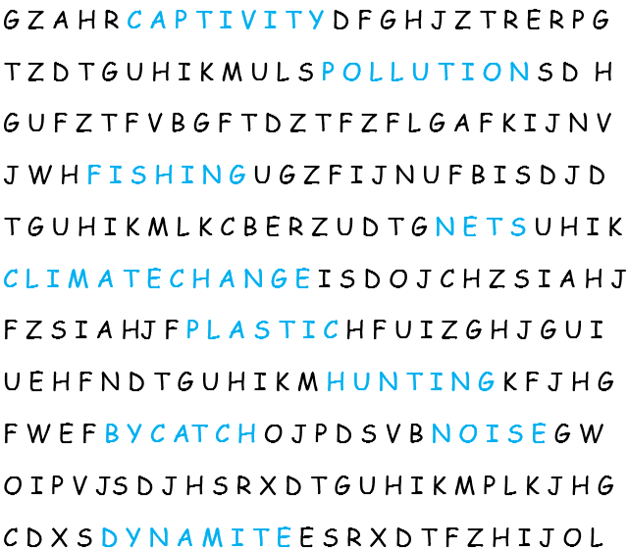
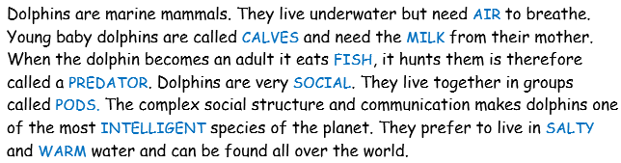
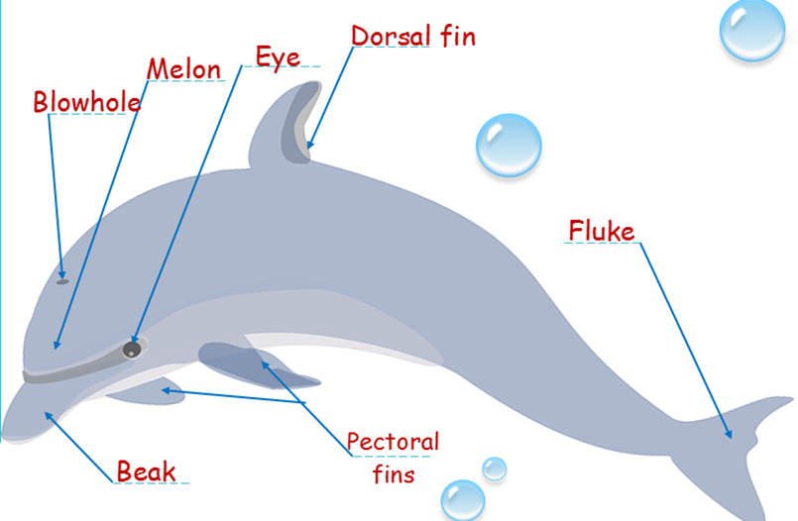
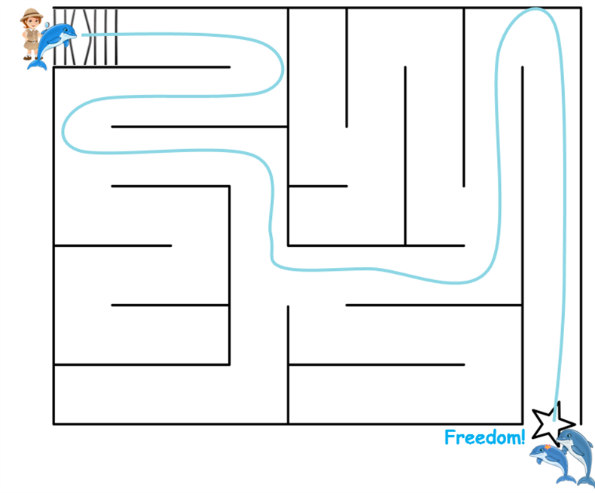
Solutions for assignments
SOLUTIONS

